Slide 1
CEE 4540
Sedimentation Tank Design: Fusion 360
Major LossesTM
Matthew Cimini, Chris Galantino, Ben Gassaway

Slide 2


AIDE’s mission of automated design needs to evolve into new software
Notes:
Ben

Slide 3
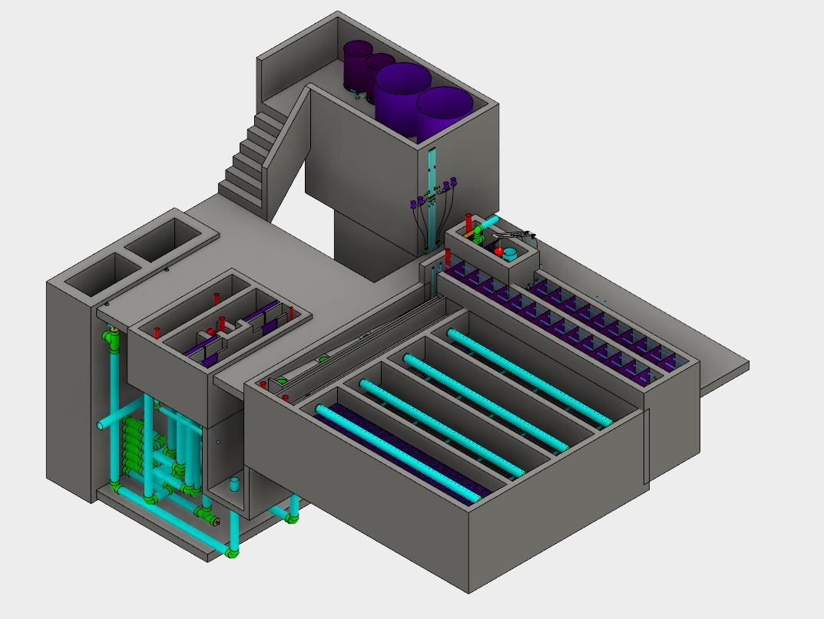
Current models do not have the capability to dynamically adjust
Notes:
Ben

Slide 4
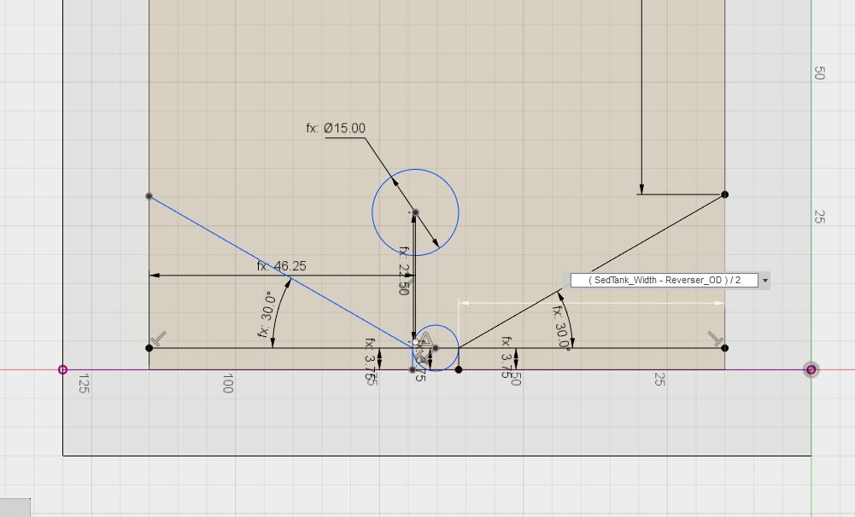
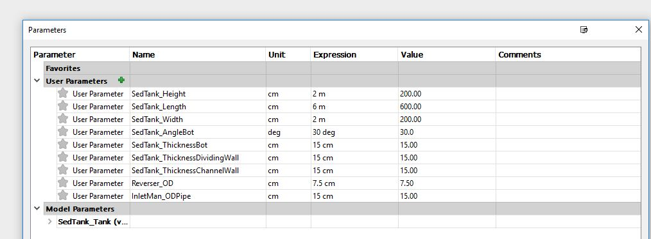
Parameterized dimensions dramatically improve design flexibility
Notes:
Matt

Slide 5
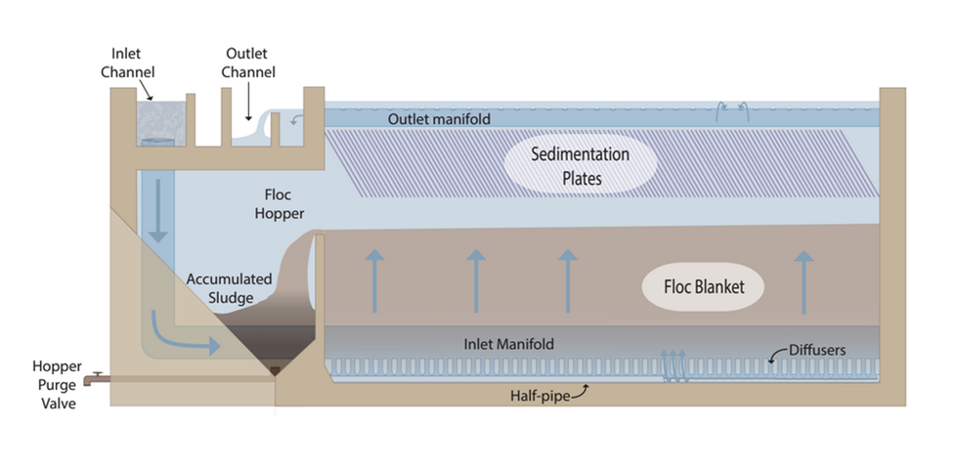
We decided to start with one component of the plant, the sedimentation tank
Notes:
Matt

Slide 6
Minimizing User Inputs maximizes ease of use
User Input
Expert Inputs
Python
Packaged Outputs
Fusion 360 Model

Slide 7



The system in action
EXPERT
Height of Sedimentation Plate Zone
EXPERT

Slide 8
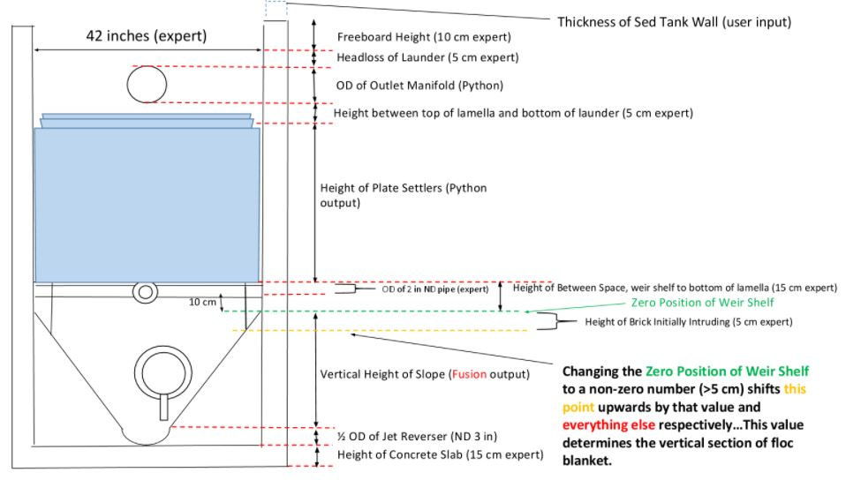
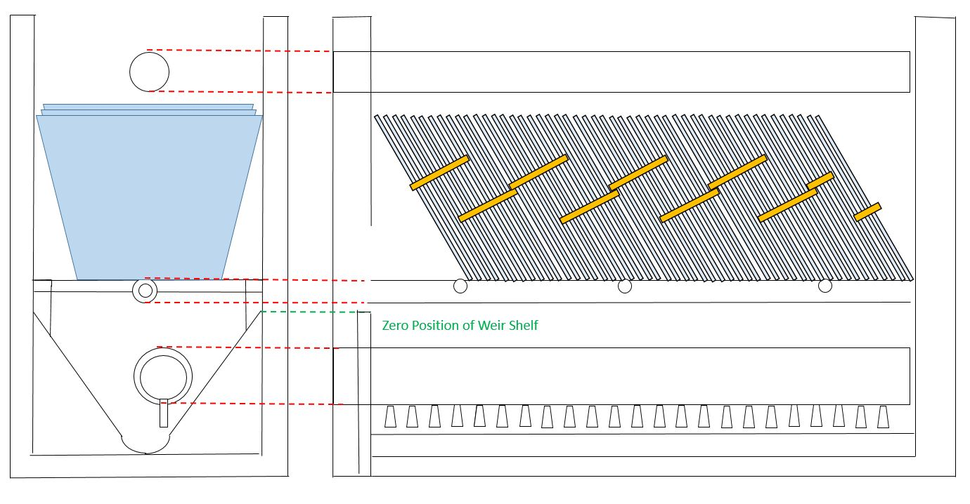
Relationships between Expert, User, Python, and Fusion calculated inputs

Slide 9
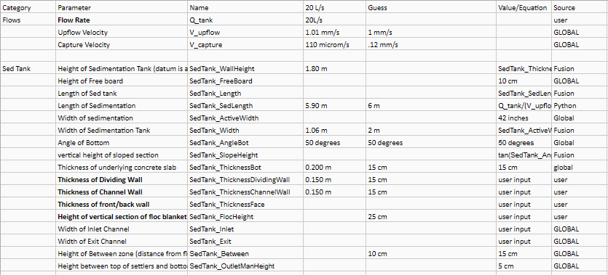
What this project has taught us...
Parametrization is a lot of work
How to develop dynamic models using Fusion 360
Importance of communication in engineering
Expert feedback, discussion, modeling

Slide 10
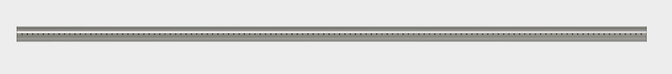
Recommendations for further development
Establish remaining relationships for parametrization
Outlet Manifold Diameter and Diameter of Holes
Length of Sedimentation Tank
Piping and Channels
Add on the inlet and outlet channels and the floc hopper
Notes:
Ben

Slide 11
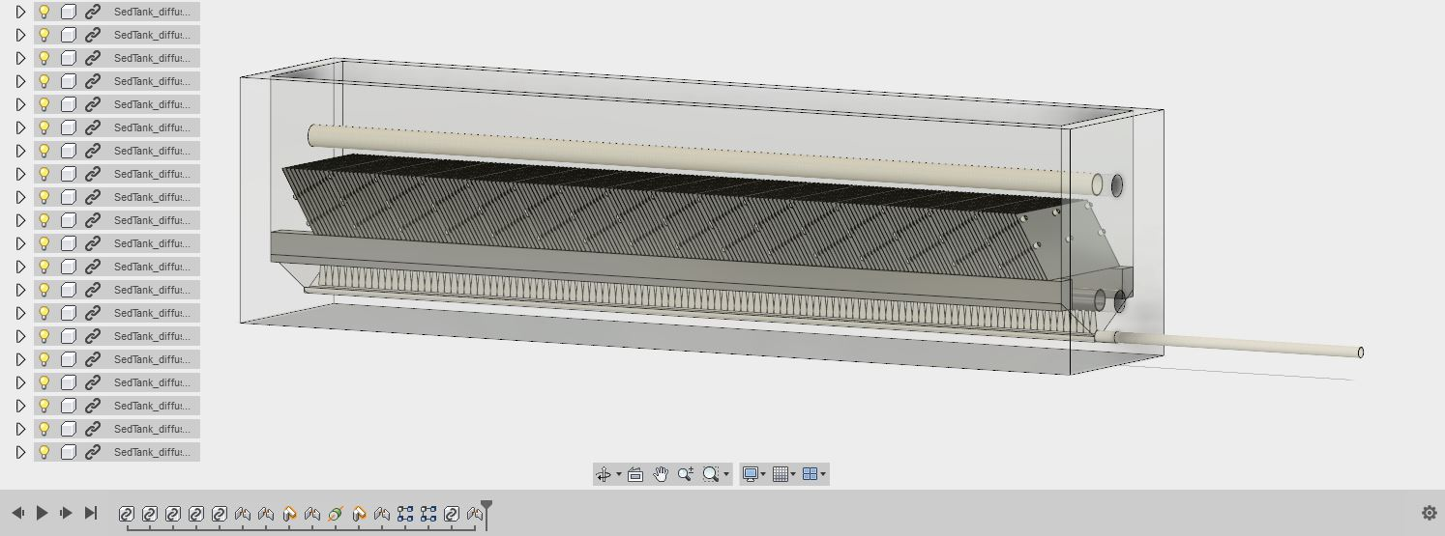
Fusion 360 adds many tools useful to modeling the sedimentation tank
Notes:
Allows archiving of each modification to components
Modularity of system to meet the unique needs of plants
Promotes effective collaboration among teams

Slide 12
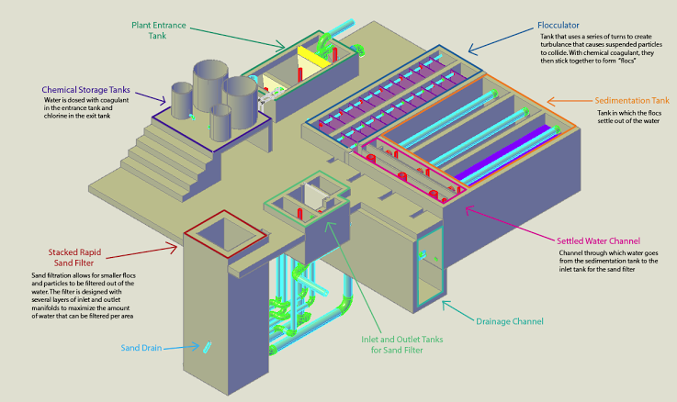

Questions?
Matt Cimini
Mechanical Engineering ‘19
mhc92@cornell.edu
Christopher Galantino Environmental Engineering ‘19
crg226@cornell.edu
Ben Gassaway
Environmental Engineering ‘18
bsg73@cornell.edu

